Slide 1
Big2small
Transfer learning from big data to small data: leveraging psychiatric neuroimaging biomarkers discovery
Kick-off chaires IA
09 July 2020

Slide 2
Outline
Neuroimaging for precision psychiatry: biomarkers
Big2Small chair: fill the gap between large heterogeneous and small homogeneous datasets
Previous achievements
Big2Small project

Slide 3
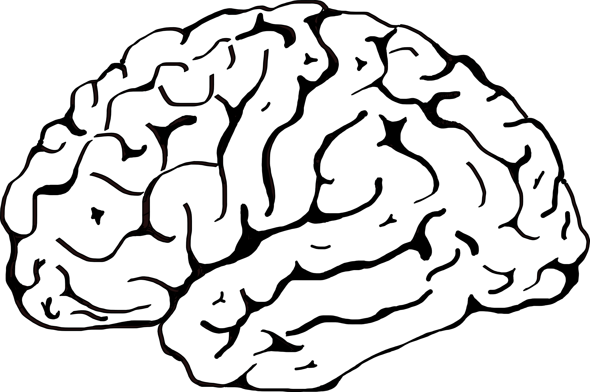
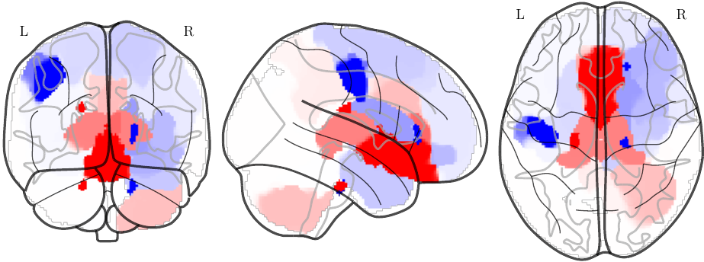
Neuroimaging base biomarkers for psychiatry
Psychiatry lacks objective quantitative measures (such as blood dosage) to guide clinicians in choosing a therapeutic strategy
Prognostic brain signatures of clinical course or response to treatment for personalized medicine in psychiatry.

Slide 4
Toward personalized medicine: early identification of subject at risk
Rational
Genetic and environment (trauma, stress, toxic, alcohol) modify the trajectory of the brain development from birth to young adults.
Subtle differences in brain functioning (fMRI) anatomy (sMRI) or connectivity (dMRI) and metabolism (PET and MRI)
genetic
environment
environment
Controls
Controls
Controls
At Risk
Goal
Prognostic of transition to psychosis at prodromal stage
Patients “at-risk” to First Episode (FE), FE to Chronic SCZ
First Episode
Chronic patient
Methods
Supervised machine learning algorithms can capture those brain patterns
Learn to predict the outcome from past brain scans at early stage of the disorder progression
Provide prognostic information about the patient evolution toward psychiatric disorders (depression, schizophrenia, bipolar-disorder).

Slide 5
Outline
Neuroimaging for precision psychiatry: biomarkers
Big2Small chair: fill the gap between large heterogeneous and small homogeneous datasets
Previous achievements
Big2Small project

Slide 6
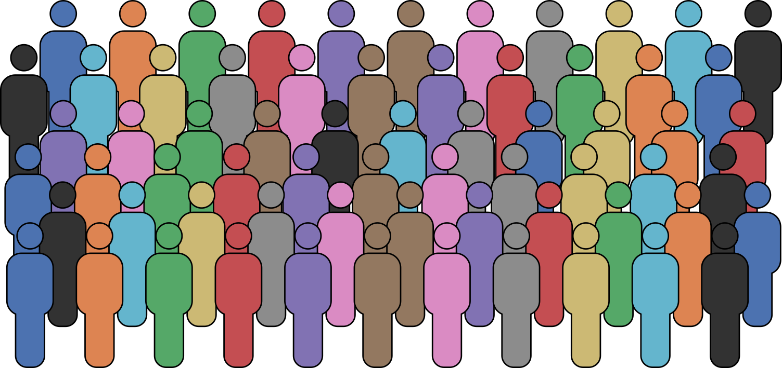
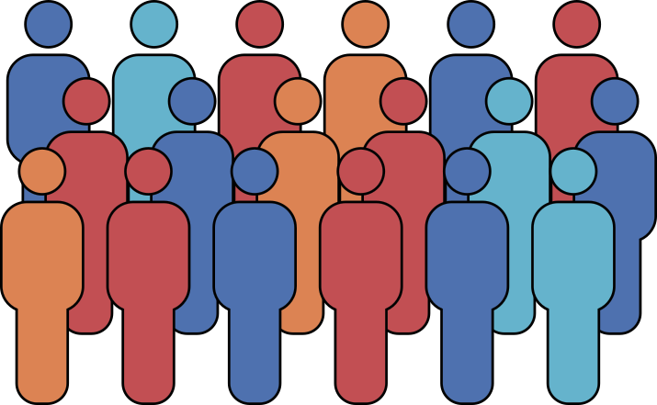
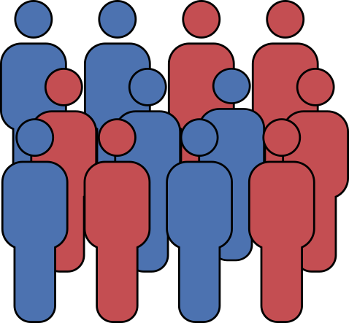
Problem: data availability
Learn the general variability
Very large datasets (N>10K) of the general population
Limited utility for psychiatry: no focus on disorder
Transfer learning
Large dataset (N~2K) for patients/healthy controls cohorts of “dirty” retrospective heterogeneous data
Limited utility for psychiatry: trivial patients/healthy controls
Transfer learning
Small homogeneous cohorts (N~500)
Longitudinal
Useful but…
10K€ / patient → 100M€ for N=10k

Slide 7
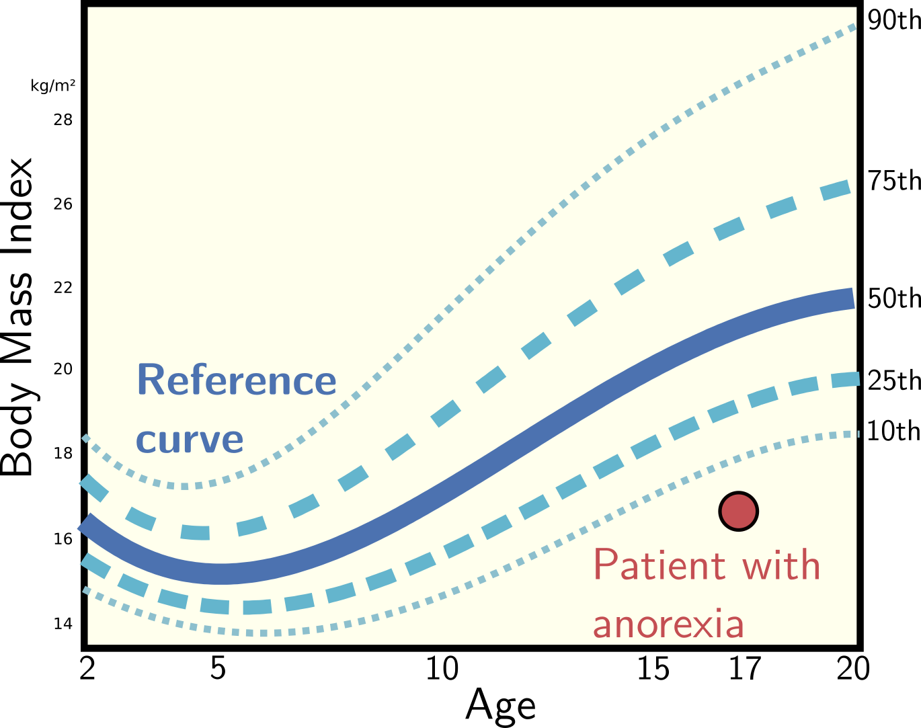
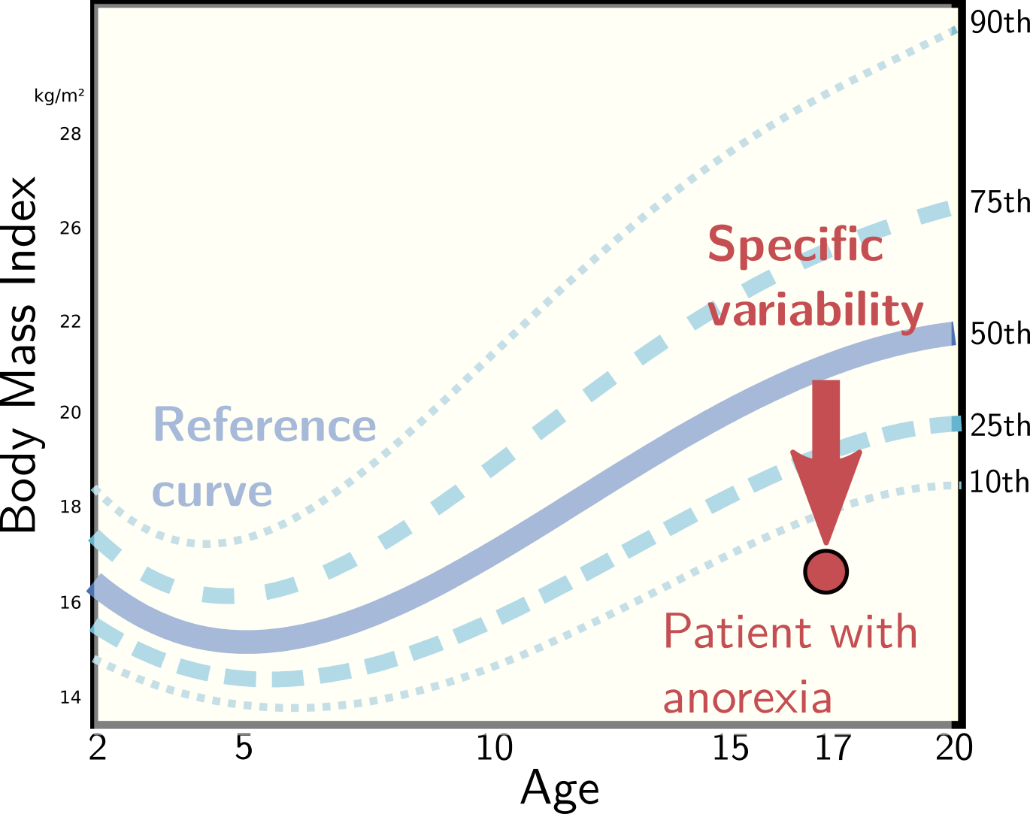
Big2Small: Transfer learning from large heterogeneous cohorts to small homogeneous cohorts
Data becomes the crux issue
Rise of “public” datasets call for new analysis strategies
Large cohorts of general population
N ≥ 10,000, transnosographic heterogeneous
(UK Biobank, HBN)
Learn the general variability
Disorder-specific retrospective and heterogeneous cohorts
N < 10,000, cross-sectional, case-control, “dirty”, limited clinical value
(schizconnect, abide, enigma)
Focus on specific variability
Disorder-specific longitudinal and homogeneous cohorts
N < 2,000, longitudinal and homogeneous cohorts, high clinical value
PsyCARE (RHU), R-LiNK, H2020, EU-AIMS
Learn useful predictive signature

Slide 8
Outline
Neuroimaging for precision psychiatry: biomarkers
Big2Small chair: fill the gap between large heterogeneous and small homogeneous datasets
Previous achievements
Big2Small project

Slide 9
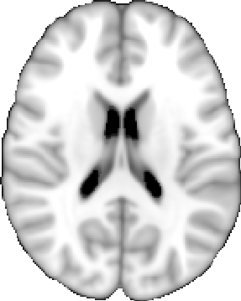
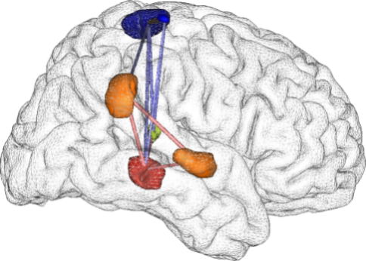
Prognosis of clinical outcome
Before
Time or treatment
Outcome
Machine Learning at a cohort level
Find a global mapping from the brain to the clinic
– Improved sensitivity
– Consider brain-brain interactions
– Over-fitting issue: need careful validation
Signature
Predict at individual level
(1) Individual computer aided diagnosis
(2) Individual prognosis of response to
treatment
(3) Imaging profile “signature” that covariate
with phenotype (clinical severity)
→ Personalized medicine‏
New patient
Good candidate
for treatment or prognosis

Slide 10
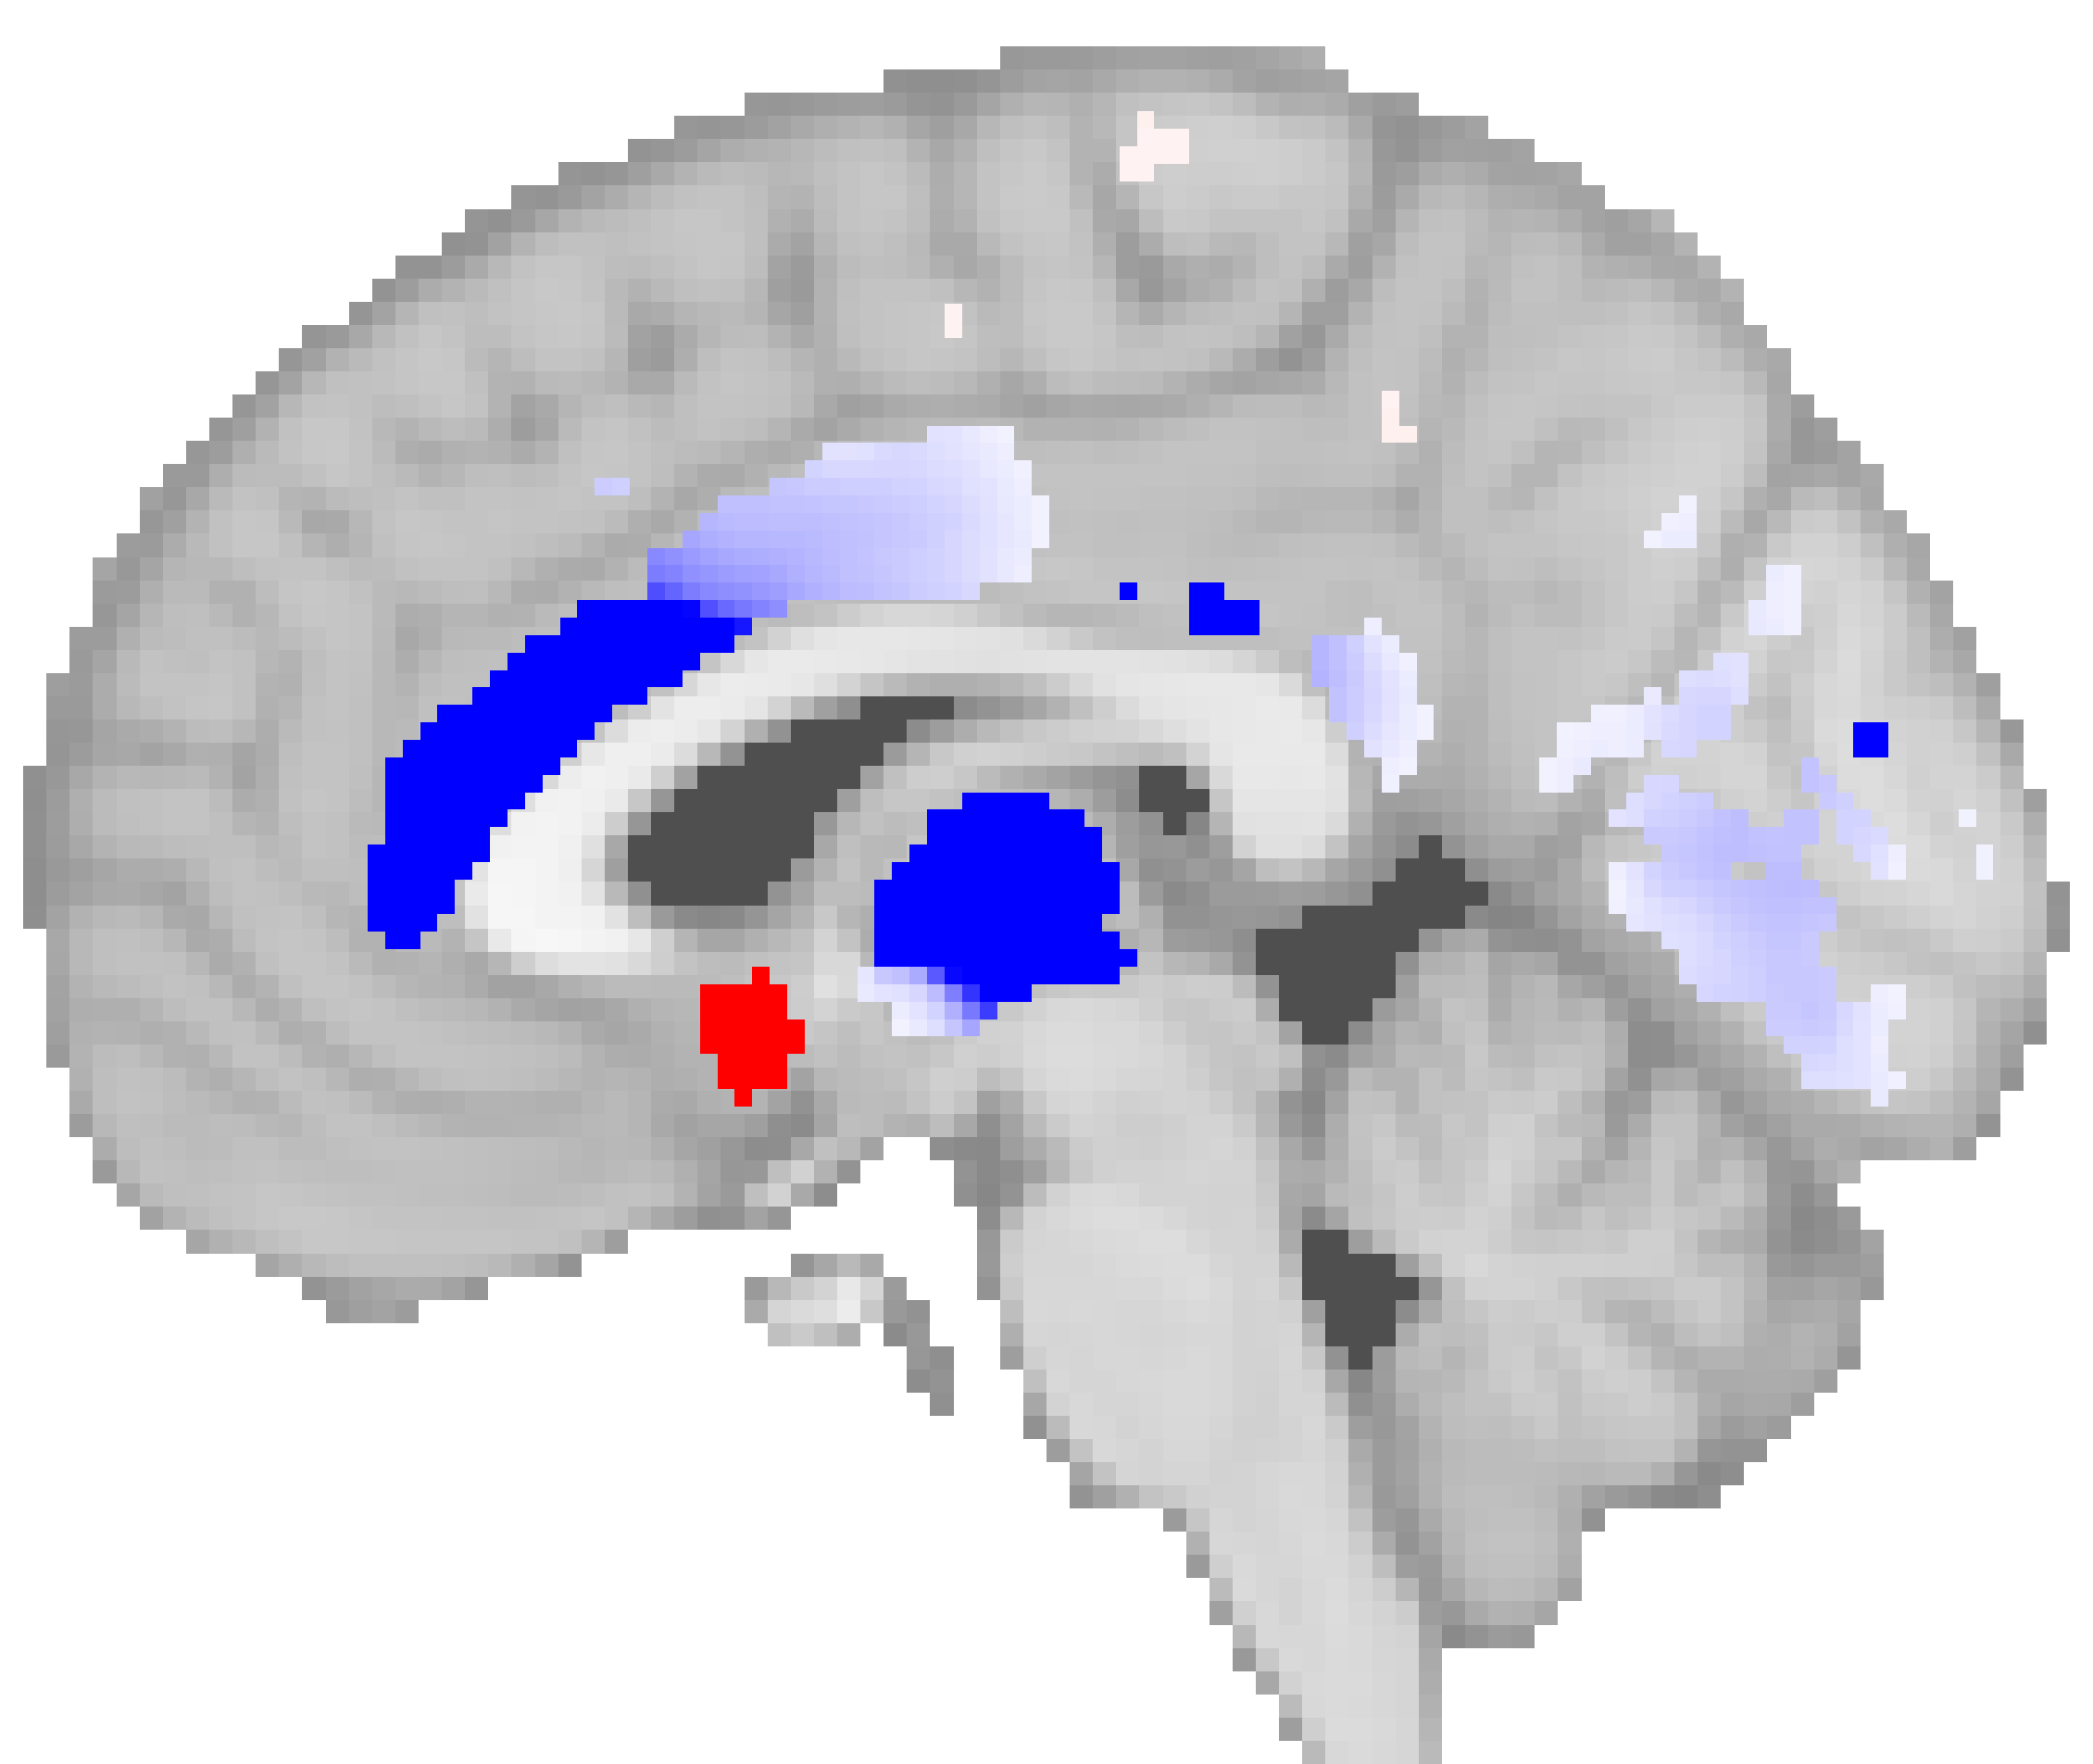
Neuroanatomical Signature of Schizophrenia that generalizes to first episode
1) Learn a Predictive signature on patients with chronic SZ and controls
[De Pierrefeu Acta Psychiatrica Scandinavica, 2018]
Collab with
- CHU Lille (R. Jardri)
- SHU Ste-Anne Paris (M.O. Krebs)
- CHU Créteil (J. Houenou)
90 Controls
330 Controls
Disorder
progression
43 first episode
of psychosis
272 patients with Chronic SCZ
genetic
environment
environment
CTL
CTL
UHR-NT
76% of
prediction
accuracy
Learn predictive
signature
UHR-T
Predictive signature
FE
2) Discriminate first episode from controls
Chronic
SCZ
Classification
rate:
?
76%
80%
3) Perspectives: brain score of disorder progression

Slide 11
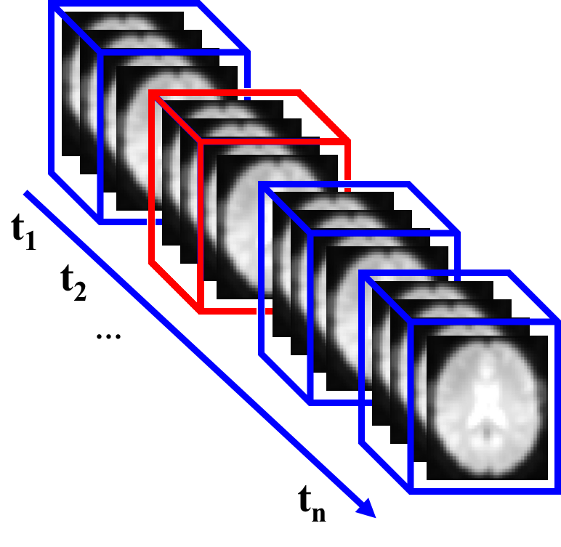
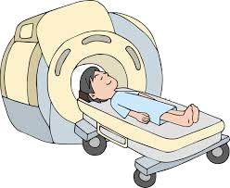
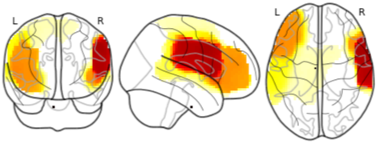
Functional MRI Activation Patterns to Predict hallucinations in Schizophrenia for neurofeedback
1) rest functional MRI during
hallucination
2) Learn functional
signature of hallucination
Predictive signature:
Broca’s area and its right homologue
3) Decoding
4) Neuro-feedback
Relax
[De Pierrefeu Hum. Brain Map., 2018]
Collab with
- CHU Lille (R. Jardri)
<number>
<number>

Slide 12
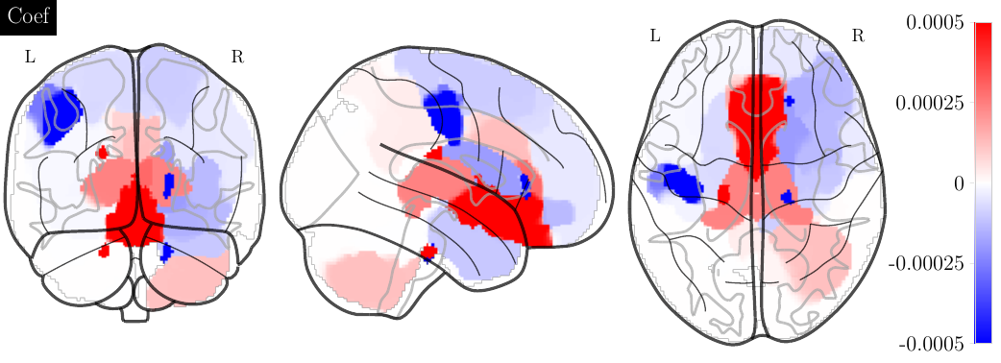
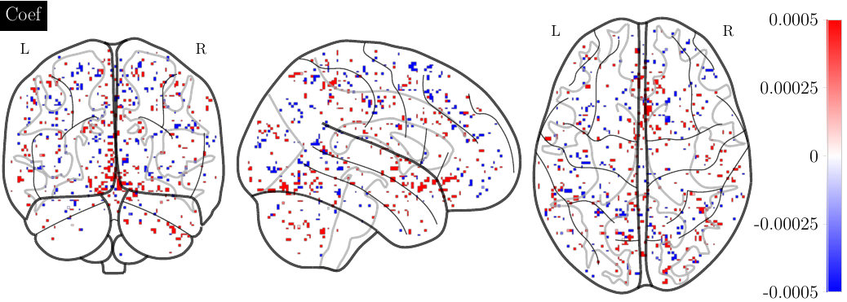
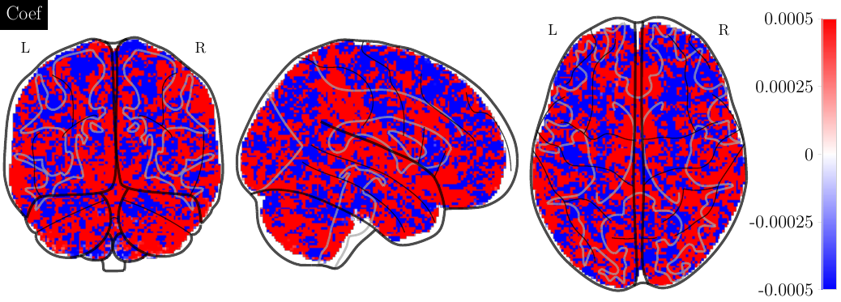
Predict psychotic transition using structural imaging in at-risk (UHR) subjects
Collab. with Ste-Anne
Anton Iftimovici
MO Krebs
Spatial
regularization
AUC: 0.79
genetic
environment
environment
CTL
CTL
UHR-NT
Lasso
AUC: 0.7
UHR-T
FE
Chronic
SCZ
Ridge
AUC: 0.66
AUC:
79%
76%
80%

Slide 13
Outline
Neuroimaging for precision psychiatry: biomarkers
Big2Small chair: fill the gap between large heterogeneous and small homogeneous datasets
Previous achievements
Big2Small project

Slide 14
Big2Small Project
Learn the general variability
Very large datasets
(N>10K)
Large dataset (N~2K) of
patients/healthy control
Encoder of the general variability:
“Manifold learning”
“Representation learning”
Small homogeneous
cohorts (N~500)

Slide 15
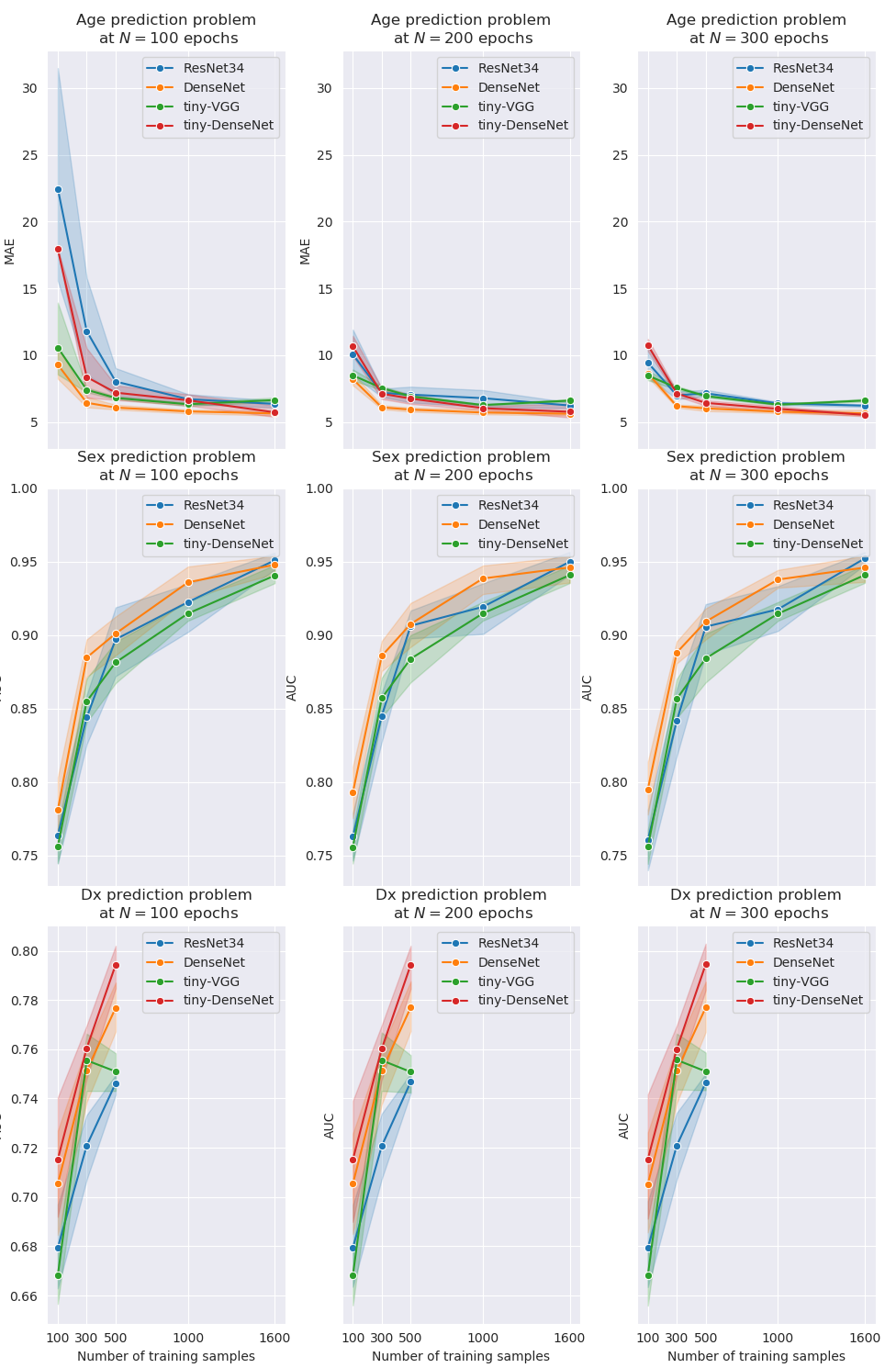
Preliminary work: benchmark deep learning architectures
Specific situation in Neuroimaging “small N large P”:
300 000 input features
100 points
So far authors used ad-hoc convolutional networks “Tiny VGG”
Benchmark more recent architectures ResNet, DenseNet, etc.
Learning curve for different sample size and problem complexity

Slide 16
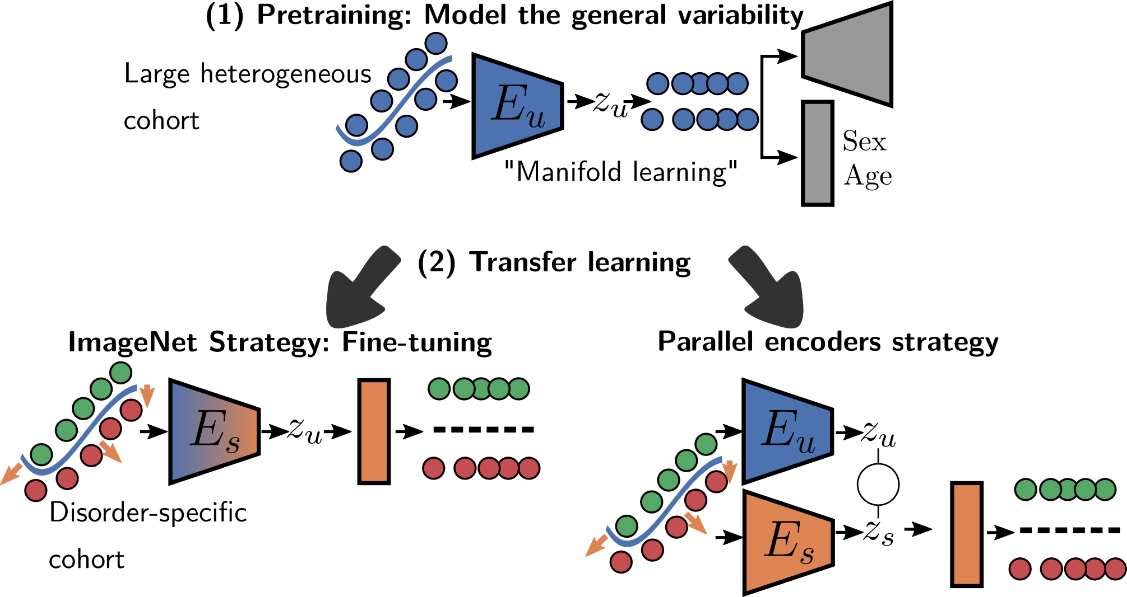
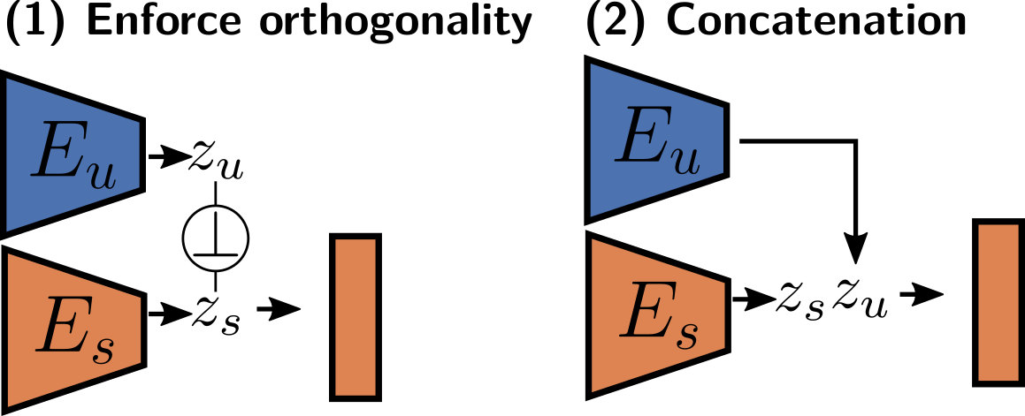
Aim 1: Representation learning strategies

Slide 17
Aim 2: Supervized prediction with embedded stratification
Disorders classification do not account for different biological etiologies
Combine losses:
– Supervized classification loss
– Clustering loss
=> Discover subtypes of patients
Patient subtype 2
Patient subtype 1
Latent space
– Max classif.
– Clustering
Controls
Patient subtype 3

Slide 18
Synergies
Network of clinicians
Josselin Houenou (Prof of Psychiatry, UPEC Univ.)
Marie-Odile Krebs (Prof of Psychiatry, Paris Descartes Univ., head of ​ Institut de psychiatrie ​ ) ​
Frank Bellivier (Prof Psychiatry, Paris Diderot Univ)
Renaud Jardri (Prof of Psychiatry, Lille Univ.) ​
Marion Leboyer (Pr. of Psychiatry, UPEC Univ., head of ​ FondaMental Foundation ) ​
Julie Bourgin (Dr. in Psychiatry, PhD. Head of Child psychiatric Dep. at Orsay Hospital) ​
Data: grants providing unique datasets
R-LiNK (H2020) Bipolar Disorder
RHU PsyCare (Schizophrenia)
Infrastructure: CATI platform
http://cati-neuroimaging.com​, PI JF Mangin

