Slide 1
CHAIR HUMAAINE : HUman-MAchine Affective Interaction & Ethics
Laurence Devillers
Professor of computer science at LIMSI-CNRS/Sorbonne
Team: Affective and social dimensions in spoken interaction with (ro)bots & Ethics
I. Vasilescu¹, G. Adda¹, H. Ali Mehenni¹, F. Le Guel², S. Pajak², T. Marquis²
¹LIMSI-CNRS, Paris-Saclay
²RITM, Department of Economics and Management, Paris-Saclay
Interdisciplinarity: Computer science/Linguistics & Behavioral economy
Kick-off Chair DATAIA - 9 Septembre 2020

Slide 2
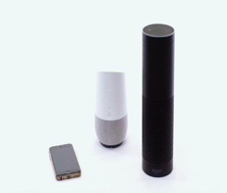
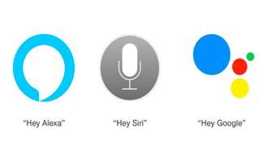
Voice is the new major consumer platform
Conversational Agents - potential to augment human welfare and well-being in many ways
improve the customer experience,
personalize the communication,
give medical advice,
create a virtual companion,
help elderly,
etc.
Affective systems (agents, robots)
Notes:
2

Slide 4
Conversational agents as research topic and ethical challenge
.
CNPEN : National Pilot Committee for Digital Ethics
The ethical issues of conversational agents
GPAI : Global Partnership on AI : The future of work (2020-24)
Notes:
What format do you want this bio in? can you provide sample?

Slide 5
HUMAAINE Goal: The interdisciplinary study of spoken machine behaviour
Scientific interdisciplinary lab. to study conversational machines, not as engineering artefacts, but as a class of agents with particular behavioral patterns and ecology.
Push forward a strong interdisciplinary collaboration between computer science, behavioral economics and linguistics at Paris-Saclay (STIC/SHS).
Create ‘affective’ chatbot/social robots
Study interactions and relationships: Notably, how will vulnerable people be protected against potential threats (dependence, isolation, manipulation/nudge) of the machine?
Audit and measure the potential influence of affective systems on humans,
Go towards a conception of "ethical systems", by design or not.
Notes:
5

Slide 6
HUMAAINE: 5 axes
Emotion detection in spoken interaction (deep learning)
Social and Affective Agents / Robots (reinforcement learning)
Scientific interdisciplinary lab. to study conversational agents behavior : impact of nudging (measures of evaluation, ethics, language features, economic issues)
Dissemination
Teaching
Notes:
6

Slide 7
Partners
Notes:
7

Slide 8
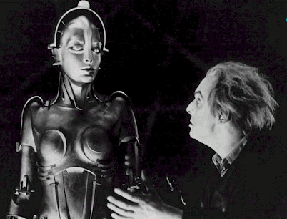
1 - Emotion detection
Interpretation Decision making
Emotion Generation and Synthesis
Computing that relates to, arises from or deliberately influences emotion or other affective phenomena (Picard, MIT 1997).
Giving technology skills of “emotion detection” for interacting with us
Emotion
detection
Metropolis (1927) Fritz Lang

Slide 9
Emotions play a central role in social interaction
3 main functions (K. Scherer) :
individual reaction to a stimuli,
physiological and psychological preparation to an appropriate action,
Communicative function of their intentions to another person
Emotional cues:
Voice (prosody : timber, energy, rythm)
Affect bursts
Face, kinect
Posture, Gestures, movement,
Eye tracking,
Behavior, Action
Temperature, Respiration, Pupil dilation, Skin conductance
ECG, EEG, Blood pressure, etc.
Notes:
Les émotions jouent un rôle central dans les interactions
les machines de demain devront avoir une “Intelligence
Emotionnelle”: savoir reconnaître, raisonner, et générer
des émotions
Quels processus affectifs pourraient avoir les machines de demain?
Détection des émotions
Gestion des émotions: compréhension et raisonnement
Génération d’émotions et d’actions liées aux émotions

Slide 10
Deep learning for social emotion detection
Emotion detection in spoken interaction using paralinguistic cues and linguistic cues (deep learning & linguistics)
Affective agent and evaluation metrics (linguistics & deep learning)
2PHDs (October 2020 - 23)
Théo Deschamps Berger (M2 AIC - Ing.)
Natalia Kalashnikova (M2 INALCO - Paris 3)
Notes:
Les émotions jouent un rôle central dans les interactions
les machines de demain devront avoir une “Intelligence
Emotionnelle”: savoir reconnaître, raisonner, et générer
des émotions
Quels processus affectifs pourraient avoir les machines de demain?
Détection des émotions
Gestion des émotions: compréhension et raisonnement
Génération d’émotions et d’actions liées aux émotions

Slide 11
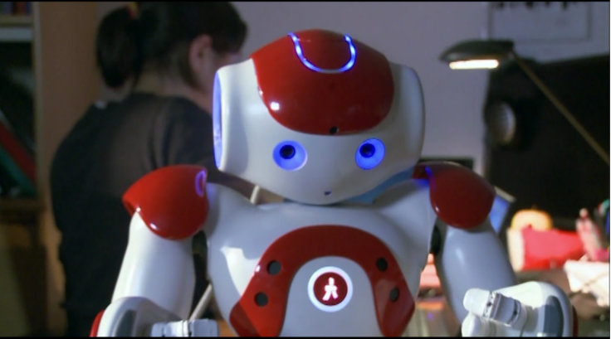
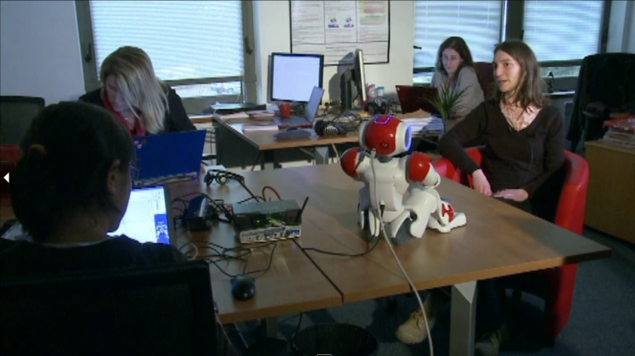
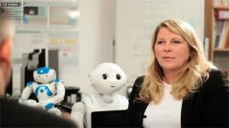
2 - Social and affective robots
We built systems and devices that can recognize, interpret, process and simulate human affect
With the capacity of interpretation of the emotional state of humans, a machine can adapt its behaviour and give an appropriate response to these emotions
Naturally, it interacts differently with different individuals

Slide 12
BAD NUDGE BAD ROBOT project
ROBOT
PERCEPTION
ROBOT
Perception system,
(Attention, Speech,
Emotion, etc.)
DIALOG SYSTEM
Low level
Cues (audio, video)
Internal robot model
User profil
USER
Memories
context
Interation
history
ACTIONS
BEHAVIOURAL DECISION
Speech synthesis
Generation, gestures, facial

Slide 13
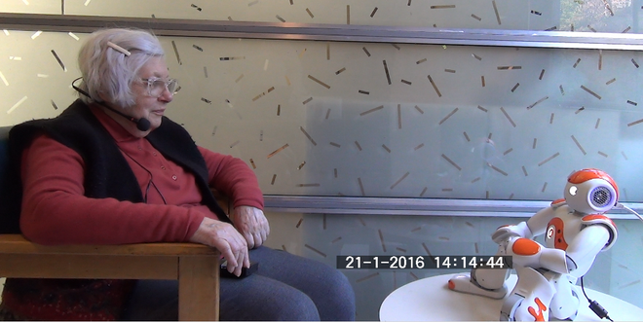
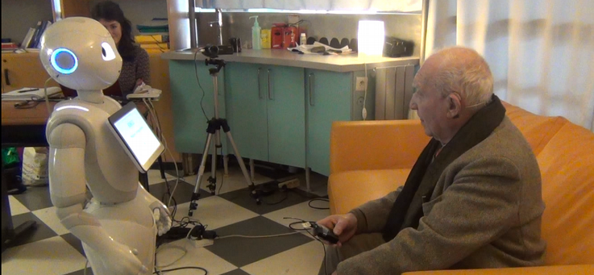
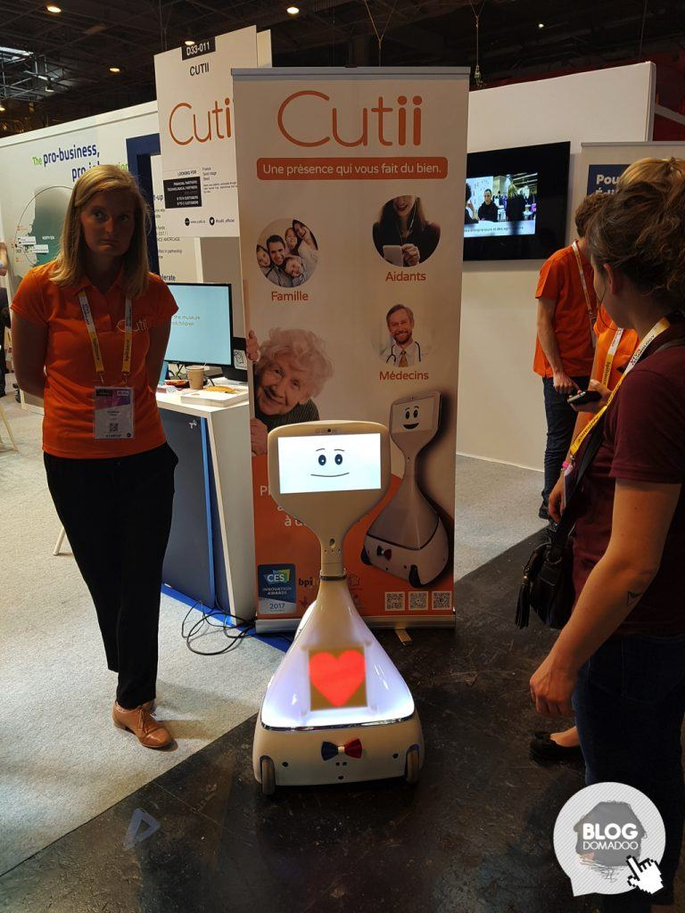
Real tests
Affective and social Robot
Adaptive behavior
Scenarios with elderly

Slide 14
3- HUMAAINE: a scientific lab. to study conversational machines
pluridisciplinary study of conversational machines (computer science, humanities)
not as engineering artefacts, but as a class of agents with particular behavioral patterns and ecology.
Notes:
14

Slide 15
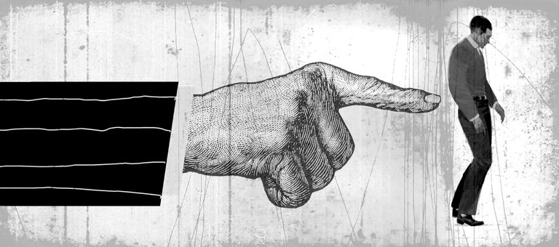
The Nudge
A “nudge” is a tactic of subtly modifying behavior of a consumer - Nudging mainly operates through the affective system. Thaler: Nobel Prize in Behavioural Economy, Nov 2017
Thaler and Sunstein (2008) - Nudges are subtle changes to the design of the environment or the framing of information that can influence our behaviors.
When conversational agents subtlety or overtly manipulate emotions and alter human behavior for commercial purposes, what kind of transparency and traceability will be present in these systems?
Notes:
What format do you want this bio in? can you provide sample?

Slide 16
Nudges work by making use of our cognitive biases and « irrational » way in decision-making
our cognitive capacities are limited,
we are lacking self-control,
we act emotionally,
we act by conformity,
We act by laziness, etc.
What is the difference between ethical nudging and aggressive nudging?
Nudging could be utilized in a near future in chatbots and social robots:
to incentivize purchase,
to influence behavior that may be and may not be desired by users

Slide 17
DATAIA Project Good - Bad nudges
Create experiments to prove that it is easy to nudge children, adults and elderly people using social and affective robots.
Affective systems with nudging strategies should be carefully evaluated and monitored -> Find metrics to be able to detect bad nudges.
Bad nudges, for example repetitive questions concerning private data, must be detected. Each of these are not — in themselves — enormous problems. But in aggregate, I would argue they constitute a form of nudging which is aggressive in nature.
Another efficient bad nudging solution will be friend agents that give us advices for holidays, for health, for fashion to influence our choices.
Creating the reputation as a "Bad-Nudge-free" system for goods and services may be a winning long-run strategy.

Slide 18
First publications
impact of nudging (measures of evaluation, ethics, language features, economic issues)
T. Marquis, F. Le Guel, S. Pajak, Nudge & vocal agent Advances with field experiments, Univ. Chicago (Sept. 2020) https://economics.uchicago.edu/content/afe-2020
H. Ali Mehenni, S. Kobylyanskaya, I. Vasilescu, L. Devillers Nudges with conversational agents and social robots: a first experiment with children at a primary school, IWSDS 2020 (Sept. 2020)
H. Ali Mehenni, S. Kobylyanskaya, I. Vasilescu, L. Devillers, Children as candidates to verbal nudging in a human-robot experiment, 1st Workshop on Social Affective Multimodal Interaction for Health, ACM ICMI (2020)
Notes:
18

Slide 19
HUMAAINE: New experiments
Game : measure altruism, measure of privacy
Education : measure of learning
Health : measure of well-being
Measures of nudging strategies impacts:
Repetitive questions
Peer effect
First person speaker (affective)
Measures of voice and language impacts:
Human/machine vocal features
Linguistics (prosody, disfluency, cultural pronunciation)
Socio-linguistic features (gender, age, culture)
Notes:
What format do you want this bio in? can you provide sample?

Slide 20
4 - Dissemination
Scientific publications, journal,
Organization of workshops
International (MILA Montreal)
2 national workshops (large audience)
Notes:
20

Slide 21
5 - Teaching
Several of our courses are focusing on epistemology, digital humanities, ethics of AI, machine learning, nudge and affective and social robots.
Courses at Paris-Saclay, Sorbonne-University, Sciences Po. (Devillers)
Serge Pajak co-heads the master program (M2) Innovation, Digital, Conseil at University Paris-Saclay where he is teaching the Digital and Ehics course. He is also teaching Ethics of field experiments in social sciences at the University Paris-Saclay doctoral program.
Fabrice Le Guel is teaching the Economics of Data and Connected Devices course.
Ioana Vasilescu is teaching an Introduction to Digital Humanities at ENEAD Sorbonne Nouvelle.
Notes:
What format do you want this bio in? can you provide sample?

Slide 22
Next steps
Collaboration with all partners involved
DATAIA PAI (industrial affiliation program)- GE1 (expert group)
Long-term issues
How will human co-learn, co-create, co-adapt with these conversational agents ?
Notably, how will vulnerable people be protected against potential threats (dependence, isolation) of the machine?
Guideline of ethics, conception of "ethical systems", by design or not
Notes:
22

