Slide 1




Apports et défis liés à l’usage de l’Intelligence Artificielle en épidémiologie clinique
Exemples applicatifs en gériatrie et oncologie
Etienne Audureau
UPEC, IMRB Inserm, Equipe CEpiA

Slide 2

Clinical Epidemiology and Ageing (CEpiA)
Geriatrics, Primary Care and Public Health
Epidemiologists, biostatisticians, geriatricians and general practioners
Heterogeneity of older subjects with/without multimorbidity and concepts of frailty
Characterization of vulnerability profiles
Detection of at-risk patients
Evaluation of prognosis and efficacy of treatments and interventions in real life setting
Methods
  Use of conventional modeling and regression approaches
  Growing interest in machine learning approaches on high-dimensional databases to more fully capture patients’ complexity
Dir. S Bastuji-Garin

Slide 3




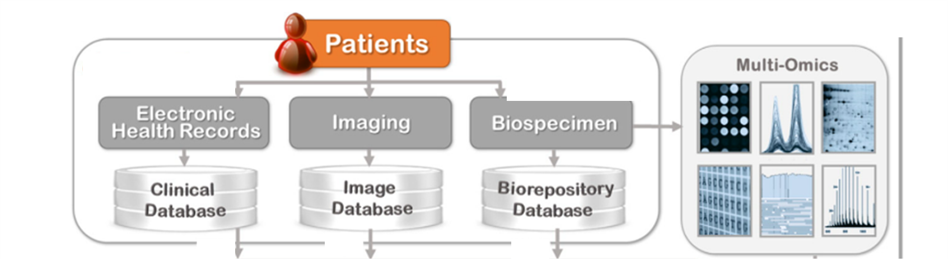
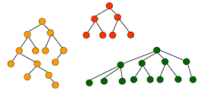
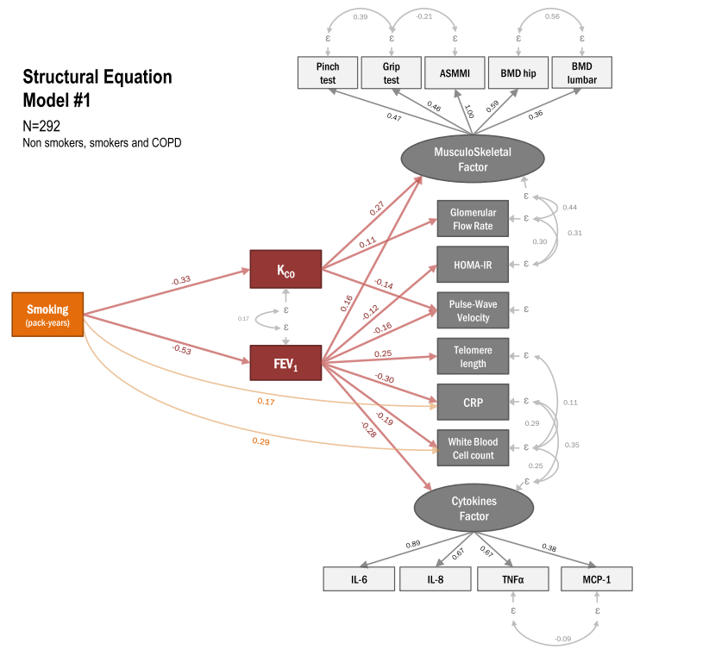
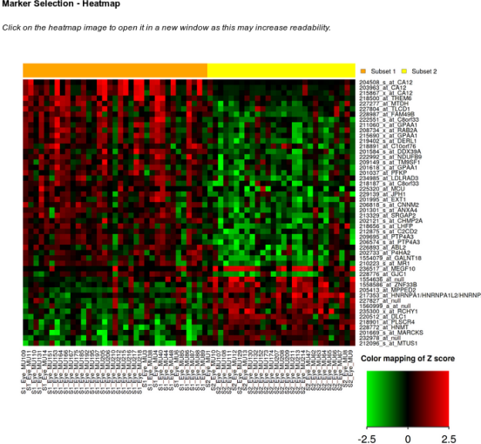
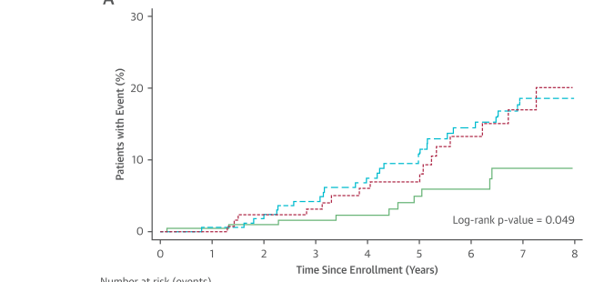
Types of studies
Patients series
Hospital
Large prospective cohorts
Hospital – Primary care
Medico-administrative databases
Electronic Health Records (EHR)
Hospital – Primary care
Objectives
Characterization of vulnerability profiles
Detection of at-risk patients
Evaluation of prognosis and efficacy of treatments and interventions in real life setting
Unsupervised analyses
Phenotypic cluster identification
Supervised analyses
Predictive algorithms for diagnosis and prognosis
Etiologic modeling
Direct and indirect causal pathways

Slide 4
Supervised approaches
Predictive tools useful for clinical practice

Slide 5
Predicting survival in older patients with cancer
Background
Prognosis establishment is crucial in oncology and geriatric oncology for decision making and risk stratification in clinical research
Both oncological and geriatric factors are independently associated with prognosis in older patients with cancer
  Altered nutritional, mobility and functional status, comorbidities and to a lesser extent depressive mood and altered cognitive functions
  Assessed through multidimensional Geriatric Assessment
An ideal prognostic tool should combine
  High predictive value in all settings and for all patients
  Clinical relevance and ease of use
Difficulties in older patients with cancer
  High heterogeneity according to cancer site, severity and underlying vulnerability of patients
  Collinearity between intertwined factors e.g. function, mobility and performance status
Interest of machine learning approaches
  Effective for modeling complex interactions between potentially correlated variables
  Limits of conventional approaches to statistical analysis unfit to deal with highly heterogeneous populations

Slide 6
Predicting survival in older patients with cancer
Background
Prognosis establishment is crucial in oncology and geriatric oncology for decision making and risk stratification in clinical research
Both oncological and geriatric factors are independently associated with prognosis in older patients with cancer
  Altered nutritional, mobility and functional status, comorbidities and to a lesser extent depressive mood and altered cognitive functions
  Assessed through multidimensional Geriatric Assessment
An ideal prognostic tool should combine
  High predictive value in all settings and for all patients
  Clinical relevance and ease of use
Difficulties in older patients with cancer
  High heterogeneity according to cancer site, severity and underlying vulnerability of patients
  Collinearity between intertwined factors e.g. function, mobility and performance status
Interest of machine learning approaches
  Effective for modeling complex interactions between potentially correlated variables
  Limits of conventional approaches to statistical analysis unfit to deal with highly heterogeneous populations
Aim ► To develop new prognostic algorithms based on decision tree-based approaches
to refine individualized prediction of overall survival in older patients with cancer
Using two prospective French cohorts
ELCAPA – Training set, N=2012
ONCODAGE – Validation set, N=1397

Slide 7
Results Predicting survival in older patients with cancer
Supervised approaches
G-8 score
p<0.001
1-year Overall survival
Single Decision Tree
<10
≥10
Tumor site Metastatic status
p<0.001
Tumor site Metastatic status
p<0.001
Subgroup #1
Subgroup #2
Subgroup #3
Subgroup #4
IADL score
p<0.001
ECOG-PS
p<0.001
Tumor site Metastatic status
p<0.001
CRP/Albumin ratio
p<0.001
<3
≥3
<3
≥3
Subgroup #5
Prostate/Breast M0
<0.22
≥0.22
CRP/Albumin ratio
p<0.001
MMSE
P=0.017
TGUG
P=0.004
ECOG-PS
p<0.001
CRP/Albumin ratio
P=0.041
CIRS-G III/IV
P=0.022
TGUG
P=0.006
<28
≥28
<0.79
≥0.79
CRP/Albumin ratio
p=0.033
<20s
≥20s or
Not feasible
<2
≥2
<0.13
≥0.13
No severe
comorbidity
≥1 severe
comorbidity
<20s
≥20s or
Not feasible
<0.82
≥0.82
#1
N=63
#2
N=65
#3
N=136
#4
N=57
#5
N=56
#6
N=83
#7
N=136
#8
N=200
#9
N=377
#10
N=191
#11
N=203
#12
N=70
#13
N=64
#14
N=81
#15
N=157
#16
N=73
1.00
0.75
Survival probability
0.50
0.25
0.00
Time (months)
Etienne Audureau

Slide 8
Results Predicting survival in older patients with cancer
Supervised approaches
G-8 score
p<0.001
1-year Overall survival
Single Decision Tree
<10
≥10
Tumor site Metastatic status
p<0.001
Tumor site Metastatic status
p<0.001
Subgroup #1
Subgroup #2
Subgroup #3
Subgroup #4
M0: Colorectal, Urinary tract, Prostate/Breast, Skin
M1: Breast
Lymphoma/Myeloma
M0: Upper digestive, Pancreas/Liver, Lung
M1: Colorectal, Upper digestive, Pancreas/Liver, Urinary tract, Prostate, Skin
Unknown origin, Head and neck
M0: Colorectal, Upper digestive, Urinary tract, Prostate/Breast, Lung,
M1: Colorectal, Breast
Lymphoma/Myeloma, Head and Neck
M0: Pancreas/Liver, Skin
M1: Upper digestive, Pancreas/Liver, Urinary tract, Prostate, Lung, Skin
Unknown primary origin
IADL score
p<0.001
ECOG-PS
p<0.001
Tumor site Metastatic status
p<0.001
CRP/Abumin ratio
p<0.001
<3
≥3
<3
≥3
Subgroup #5
Prostate/Breast M0
<0.22
≥0.22
M0: Colorectal, Upper digestive, Urinary tract, Lung,
M1: Colorectal, Breast
Lymphoma/Myeloma, Head and Neck
CRP/Abumin ratio
p<0.001
MMSE
P=0.017
TGUG
P=0.004
ECOG-PS
p<0.001
CRP/Abumin ratio
P=0.041
CIRS-G III/IV
P=0.022
TGUG
P=0.006
<28
≥28
<0.79
≥0.79
CRP/Abumin ratio
p=0.033
<20s
≥20s or
Not feasible
<2
≥2
<0.13
≥0.13
No severe
comorbidity
≥1 severe
comorbidity
<20s
≥20s or
Not feasible
<0.82
≥0.82
#1
N=63
#2
N=65
#3
N=136
#4
N=57
#5
N=56
#6
N=83
#7
N=136
#8
N=200
#9
N=377
#10
N=191
#11
N=203
#12
N=70
#13
N=64
#14
N=81
#15
N=157
#16
N=73
1.00
0.75
Survival probability
0.50
0.25
0.00
Time (months)
Etienne Audureau

Slide 9
Results Predicting survival in older patients with cancer
Supervised approaches
G-8 score
p<0.001
1-year Overall survival
Single Decision Tree
<10
≥10
Tumor site Metastatic status
p<0.001
Tumor site Metastatic status
p<0.001
Subgroup #1
Subgroup #2
Subgroup #3
Subgroup #4
IADL score
p<0.001
ECOG-PS
p<0.001
Tumor site Metastatic status
p<0.001
CRP/Albumin ratio
p<0.001
<3
≥3
<3
≥3
Subgroup #5
Prostate/Breast M0
<0.22
≥0.22
CRP/Albumin ratio
p<0.001
MMSE
P=0.017
TGUG
P=0.004
ECOG-PS
p<0.001
CRP/Albumin ratio
P=0.041
CIRS-G III/IV
P=0.022
TGUG
P=0.006
<28
≥28
<0.79
≥0.79
CRP/Albumin ratio
p=0.033
<20s
≥20s or
Not feasible
<2
≥2
<0.13
≥0.13
No severe
comorbidity
≥1 severe
comorbidity
<20s
≥20s or
Not feasible
<0.82
≥0.82
#1
N=63
#2
N=65
#3
N=136
#4
N=57
#5
N=56
#6
N=83
#7
N=136
#8
N=200
#9
N=377
#10
N=191
#11
N=203
#12
N=70
#13
N=64
#14
N=81
#15
N=157
#16
N=73
1.00
0.75
Survival probability
0.50
0.25
0.00
Time (months)
Etienne Audureau

Slide 10
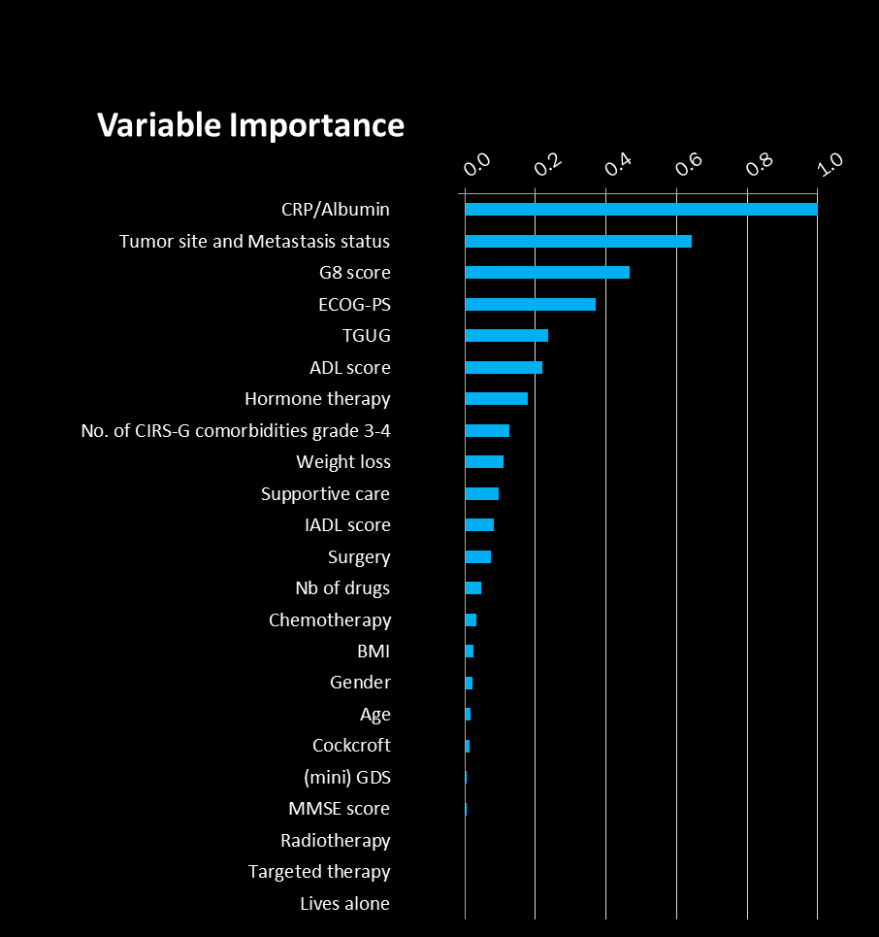
Results
Supervised approaches
1-year Overall survival
Survival Random Forest
(1000 decision trees)
Etienne Audureau

Slide 11
Results Predicting survival in older patients with cancer
Supervised approaches
Comparison of the predictive performance across models
Harrell C-indexes
Improved prediction performance
But increased complexity for implementation and understanding
in routine clinical practice (« black box »)
Etienne Audureau

Slide 12
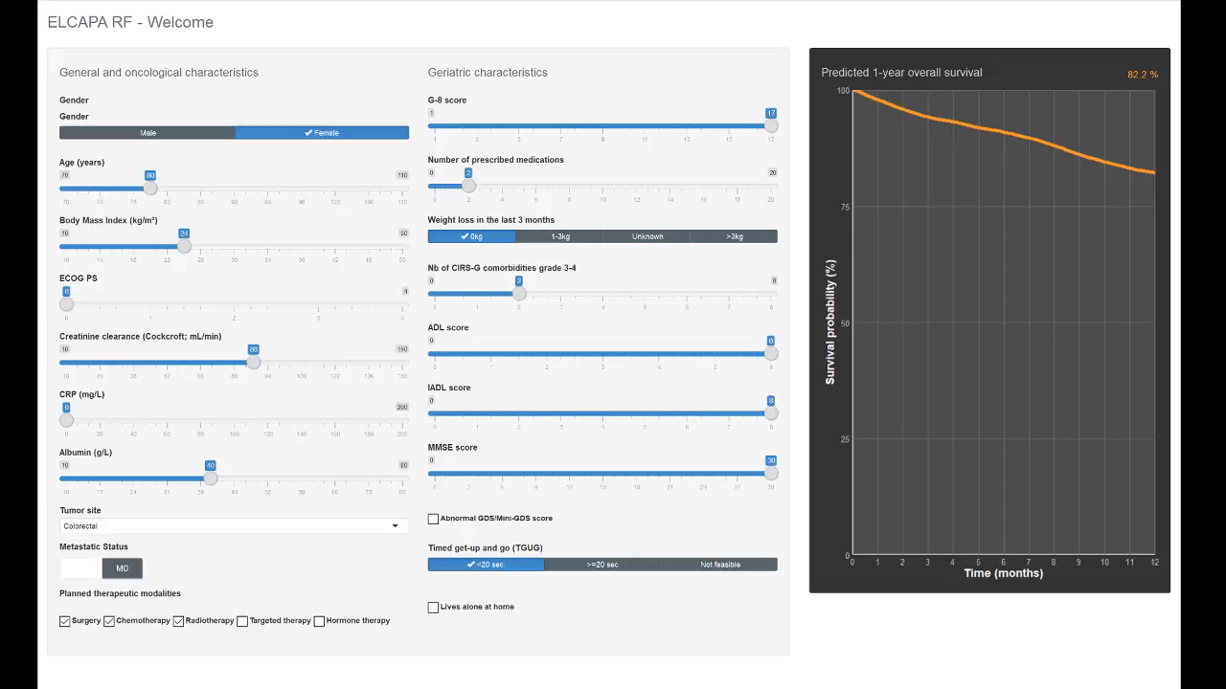

Slide 13

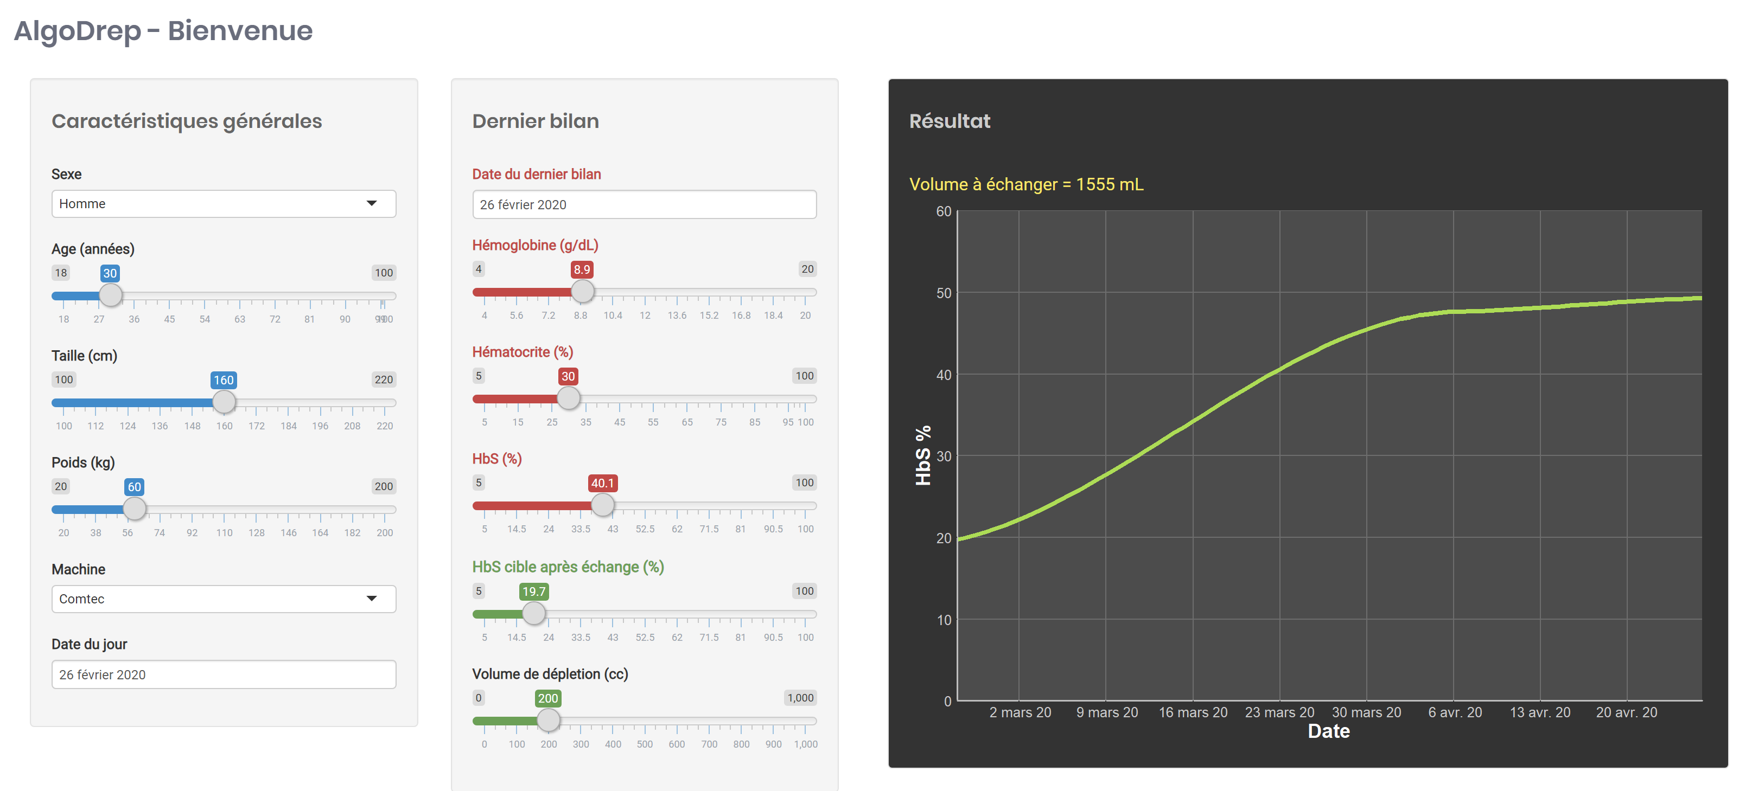
Exemple (2) : Sickle cell disease
Prediction of the required blood volume to transfuse and helper for care planification
Supervised approaches (2)
Prediction by Extreme Gradient Boosting (xgboost)

Slide 14
Unsupervised approaches
Identification and characterization of typical profiles

Slide 15

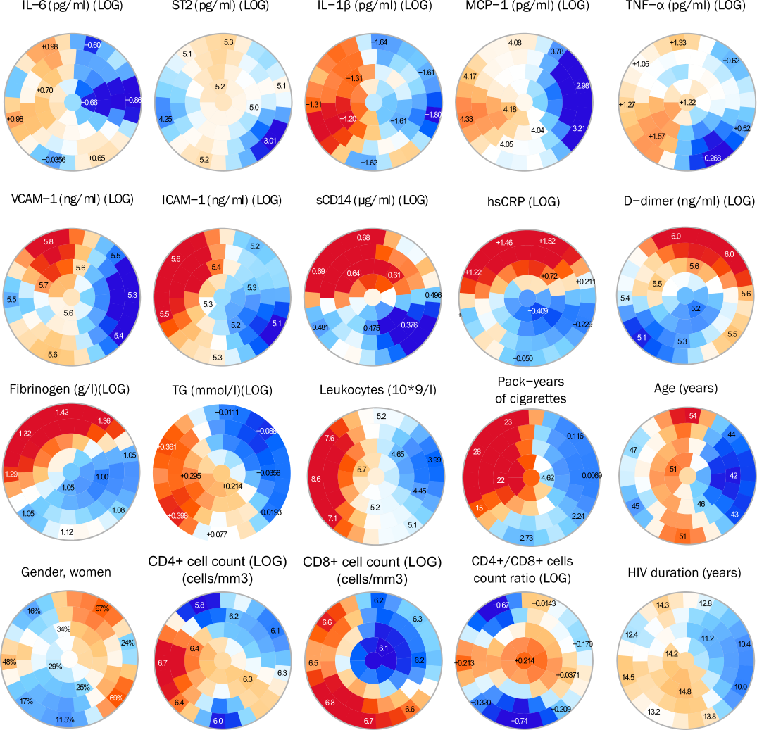

















Exemple (1) : Persons living with HIV
Identification of chronic inflammation profiles
Unsupervised approaches
Clusters
Inflammatory/age/smoking/HIV-related profiles
High
Low
Cluster A.
Heaviest Smokers / Global inflammatory response (ICAM-1, IL-6, IL1-β, MCP-1, TNF-α,)
Cluster B.
Smokers / Global inflammatory response (VCAM-1, hsCRP, D-dimers, sST2, sCD14) and lower CD4⁺/CD8⁺ ratio than A.
Cluster C.
Highly specific Inflammatory response (D-dimer, hsCRP)
Cluster D.
Low inflammatory response / best HIV-related parameters
Cluster E.
Moderate inflammatory response / lowest CD4⁺/CD8⁺ ratio
Patterns of inflammation and comorbidity in Human Immunodeficiency Virus (HIV) infection: a clustering analysis from the CARDAMONE study.
S Zebachi, S Hüe, L Boyer, S Gallien, M Surenaud, JL Lopez Zaragoza, JD Lelièvre, S Gallien and E Audureau

Slide 16

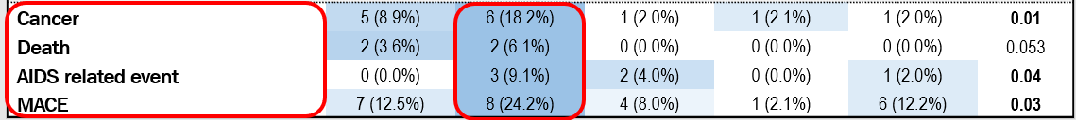
Exemple (1) : Persons living with HIV
Identification of chronic inflammation profiles
Unsupervised approaches
Clusters
Inflammatory/age/smoking/HIV-related profiles
High
Low
Cluster A.
Heaviest Smokers / Global inflammatory response (ICAM-1, IL-6, IL1-β, MCP-1, TNF-α,)
Cluster B.
Smokers / Global inflammatory response (VCAM-1, hsCRP, D-dimers, sST2, sCD14) and lower CD4⁺/CD8⁺ ratio than A.
P-value
Cluster C.
Highly specific Inflammatory response (D-dimer, hsCRP)
Cluster D.
Low inflammatory response / best HIV-related parameters
Cluster E.
Moderate inflammatory response / lowest CD4⁺/CD8⁺ ratio
Patterns of inflammation and comorbidity in Human Immunodeficiency Virus (HIV) infection: a clustering analysis from the CARDAMONE study.
S Zebachi, S Hüe, L Boyer, S Gallien, M Surenaud, JL Lopez Zaragoza, JD Lelièvre, S Gallien and E Audureau

Slide 17
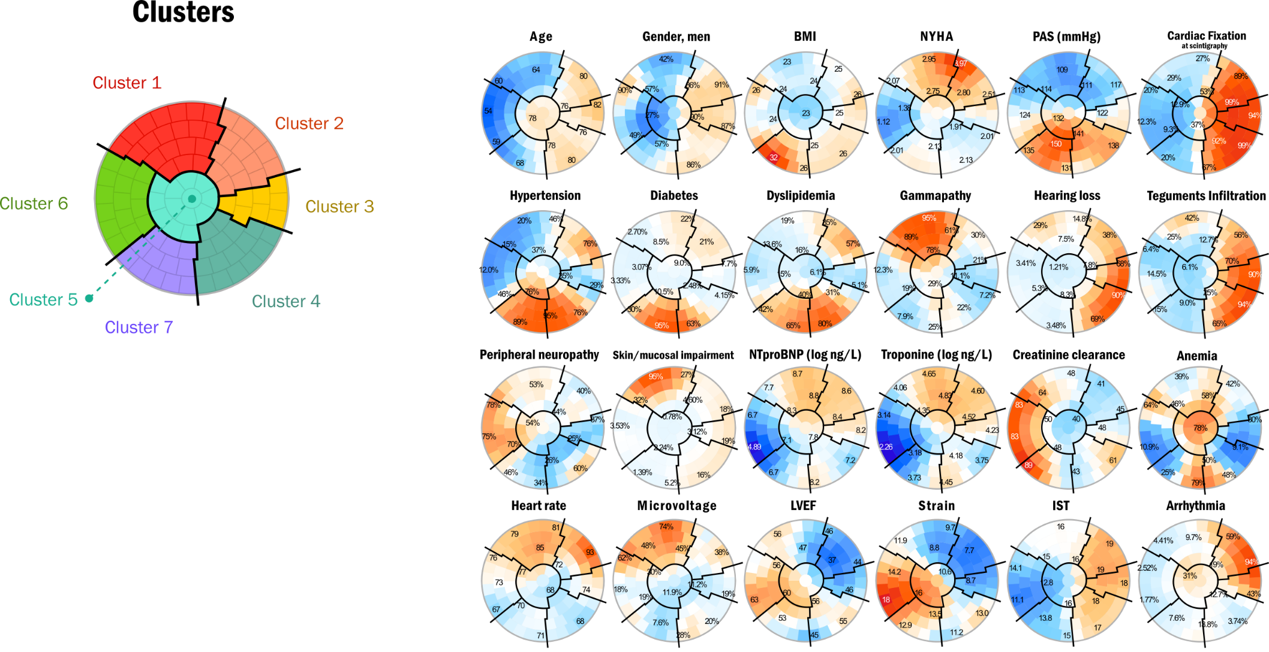
Exemple (2) : Cardiac Amyloidosis
To identify and characterize cardiac amyloidosis subtypes based on clinical and cardiologic features
Assessing cardiac amyloidosis subtypes through unsupervised clustering analysis: implications for diagnosis and risk stratification. Bonnefous L,…, Audureau E

Slide 18
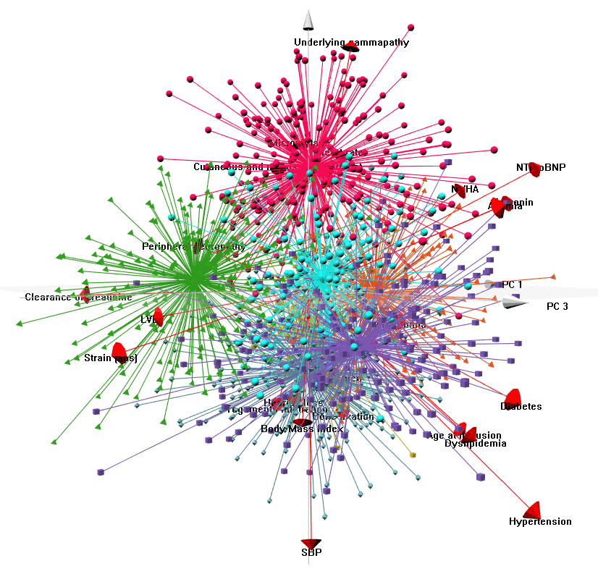
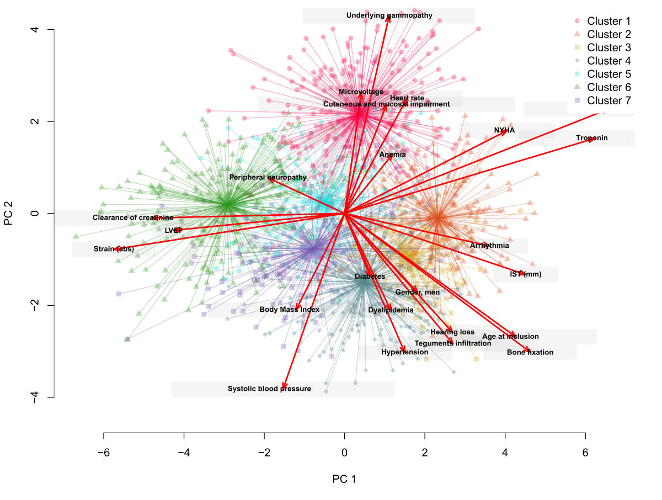
Exemple (2) : Cardiac Amyloidosis

Slide 19
Electronic Health Records and large medico-administrative databases
Enlarging the scope…

Slide 20
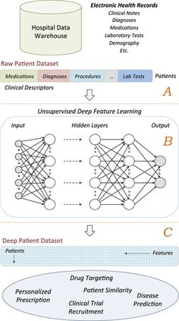
AI Chair project
Entrepôt de données de Santé (EDS)
AP-HP, CentraleSupelec, INRIA
Data from medical electronic health records
  Health Data repository (EDS) AP-HP
  Structured and unstructured
  Clinical (diagnoses, text mining from hospitalization reports) imaging, prescriptions, care pathways, etc.
Machine learning and deep learning
  Patients representations
  Diagnostic and prognostic predictions
  Personalized medicine

Slide 21
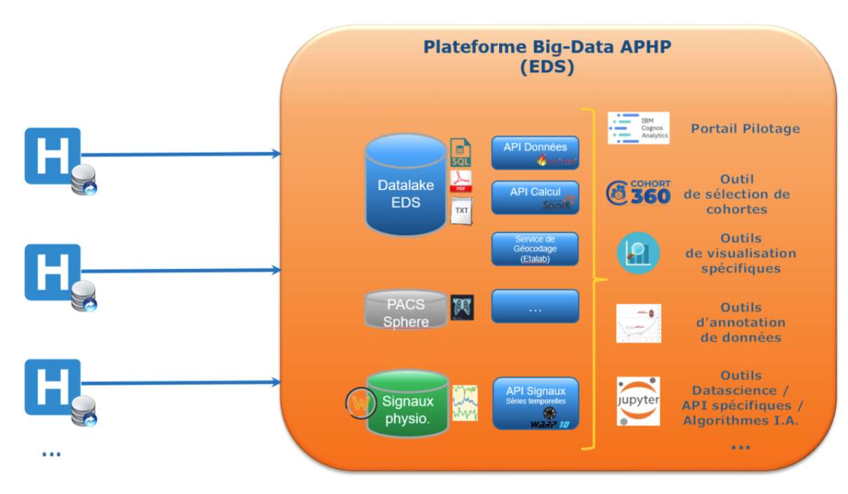
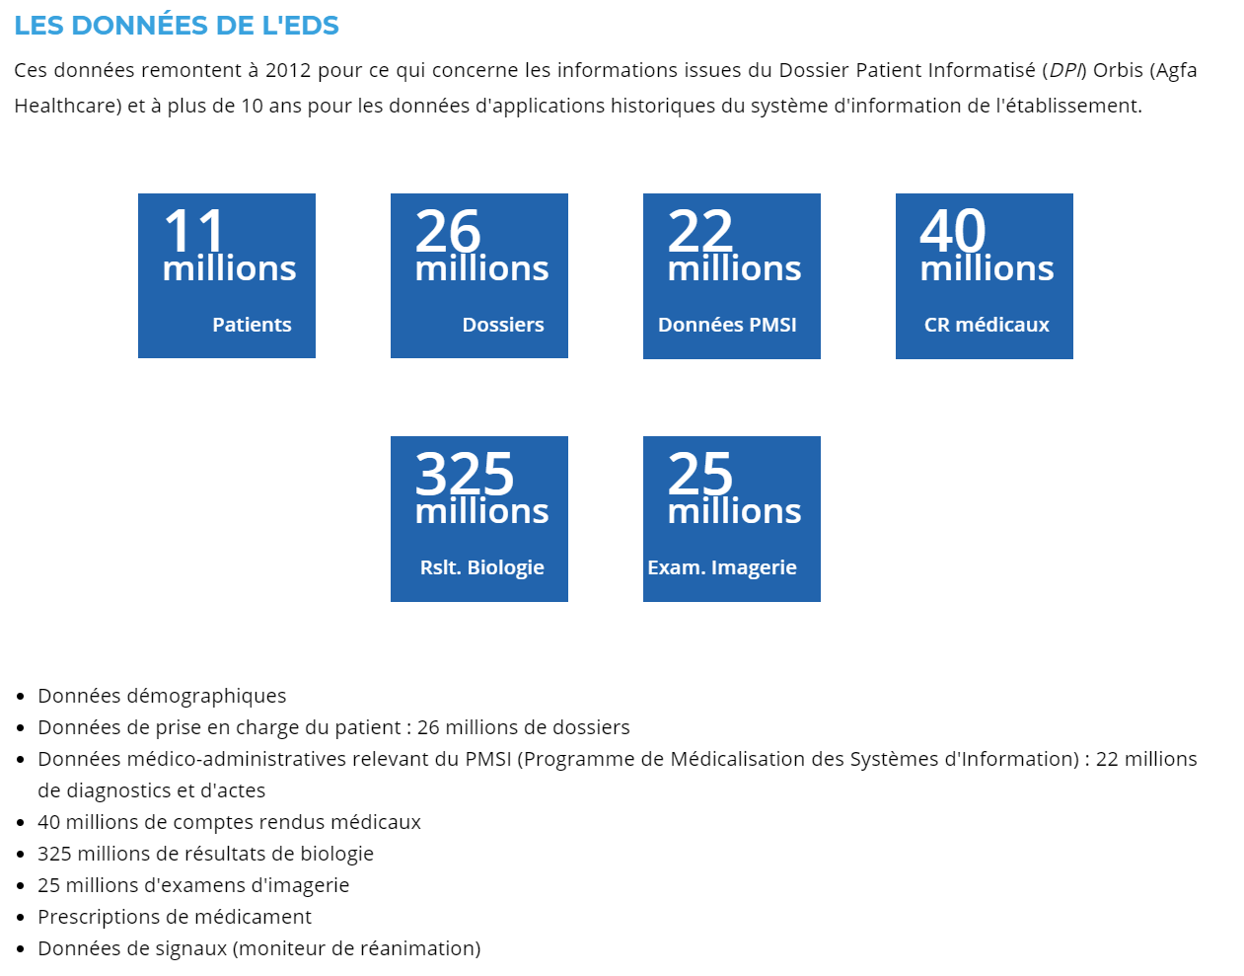
Data from AP-HP Data repository
Ces données remontent à 2012 (Dossier Patient Informatisé Orbis) et à plus de 10 ans pour les données d'applications historiques du système d'information de l'établissement.

Slide 22
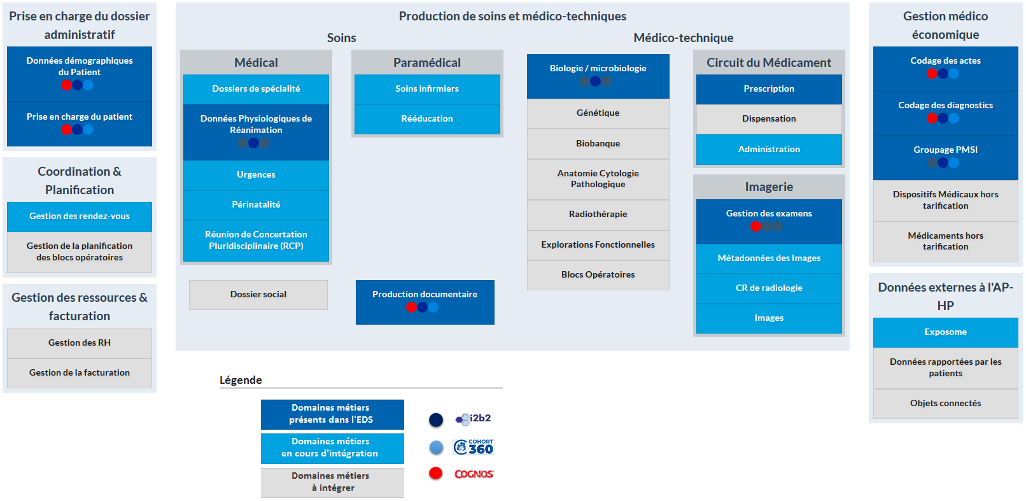
Data map

Slide 23
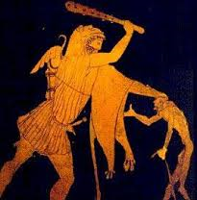



Intelligence artificielle pour le phénotypage et l’évaluation du pronostic des sujets vieillissants et/ou atteints de cancer
AI-RACLES: Artificial Intelligence to decipher Ageing and Cancer-reLated heterogeneity and outcomES.
Etienne Audureau
Laurent Le Brusquet
Arthur Tenenhaus
Thomas Guyet
AP-HP, CEpiA
(Inserm, U955, IMRB, UPEC)
Laboratoire des Signaux et des Systèmes
(UMR CentraleSupélec – CNRS – Paris-Sud)
LACODAM
(Large-Scale Collaborative Data Mining, INRIA)
Applicative research
Methodological research
Heterogeneity +++ older patients and frailty concepts
Challenges
  Characterization of vulnerability profiles
  Detection of at-risk patients
  Evaluation of prognosis and efficacy of treatments and interventions in real life setting
Expected benefits from machine learning approaches on high-dimensional databases
Heterogenous data integration
Representation of patients and identification of typical profiles and care pathways
Standardization (OMOP format) and use of synthetic data: impact on loss of information and reidentification risk

Slide 24
Research program
Axe 1 – Identification de phénotypes de fragilité et trajectoires de soins des sujets âgés et/ou multimorbides
Thème - Phénotypage à haut débit et Représentation du patient
Thème - Intégration de données hétérogènes
1
2
Axe 2 – Construction d’outils prédictifs en oncologie et oncologie gériatrique
Thème - Intégration de données hétérogènes
3
Axe 3 – Approches comparatives supervisées et non supervisées sur données synthétiques
et issues du modèle OMOP
Thème - Génération de données synthétiques
Thème - Standardisation des données
Exploited data
Clinical (diagnoses, text mining from hospitalization reports), imaging, lab results, prescriptions, care pathways
Collaboration with other teams with relevant expertise (e.g. NLP text mining Xavier Tannier LIMICS)
Notes:
Les variables considérées pour réaliser le clustering incluront à la fois des caractéristiques cliniques (diagnostics, analyses des comptes-rendus textuels), d’examens de laboratoire, de comptes-rendus d’imagerie, de prescription, ainsi que les éléments relatifs au parcours de soins des patients
Des collaborations seront activement recherchées auprès d’autres équipes de recherche aux domaines d’expertise très spécifiques utiles au projet mais non directement couverts par le programme de recherche présenté ici. En particulier, l’extraction de données issues des comptes rendus textuels en lien avec la thématique 5 (extraction d’informations d’intérêt à partir de données non structurées) s’appuiera sur une collaboration mise en place avec Xavier Tannier et son équipe (LIMICS, Laboratoire d'Informatique Médicale et d'Ingénierie des Connaissances en e-Santé, UMRS 1142).

Slide 25
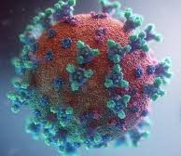



Avant la Chaire….
COVIPREDS – Entrepôt de données de Santé AP-HP
avec AP-HP, CentraleSupelec, INRIA
Caractérisation et prédiction de la survenue de formes graves ou létales du COVID-19 à partir des données issues de l’EDS de l’AP-HP : projet COVIPREDS
Etienne Audureau
Laurent Le Brusquet
Arthur Tenenhaus
Thomas Guyet
1
Objectif principal
Développer des modèles prédictifs de la survenue de formes graves ou létales du COVID-19 à partir des données issues de l’EDS de l’AP-HP
Objectifs secondaires
Réaliser une typologie des patients atteints d’une forme grave ou létale du COVID-19 basée sur des méthodes non supervisées d’apprentissage profond
Développer des modèles prédictifs de durée d’hospitalisation et des parcours de soins
2

Slide 26
Growing interest for machine learning approaches in clinical epidemiology, in patients’ cohorts and large EHR databases
Challenges
- Understanding models and documenting their real-life usefulness
- Acceptability by patients and physicians and ethics-related issues

